Slide 1
Expanded iPhone Data Analysis
Includes Additional Pie Charts

Slide 2
Overview
- Expanded analysis of fictional iPhone company data
- Includes sales, regions, storage variants, and sales channels

Slide 3
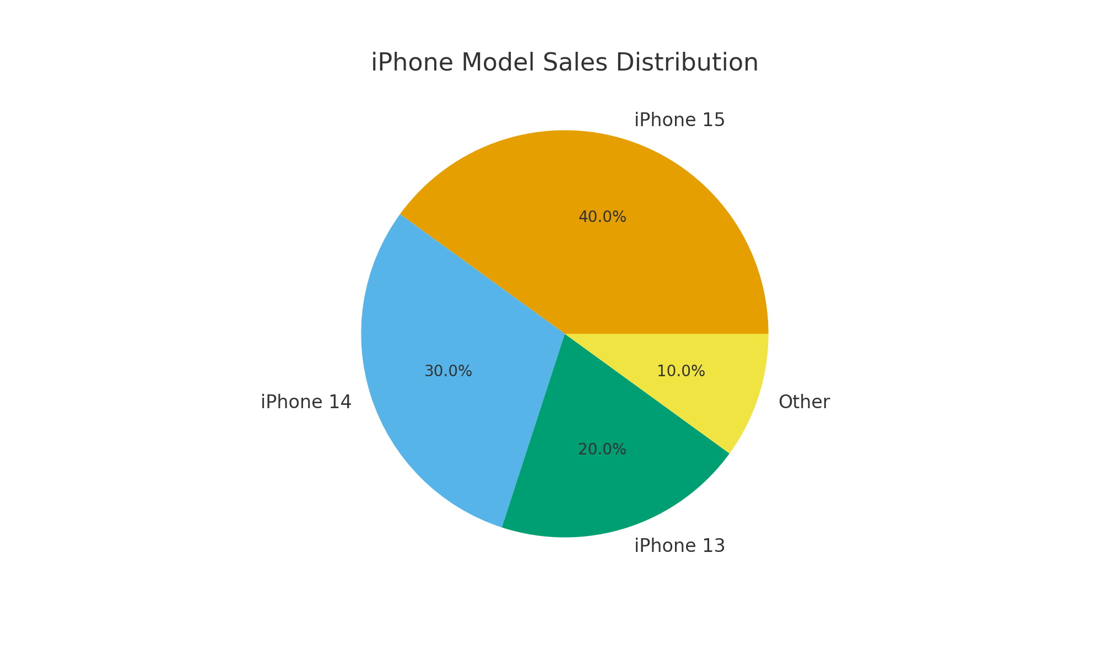
iPhone Model Sales Distribution

Slide 4
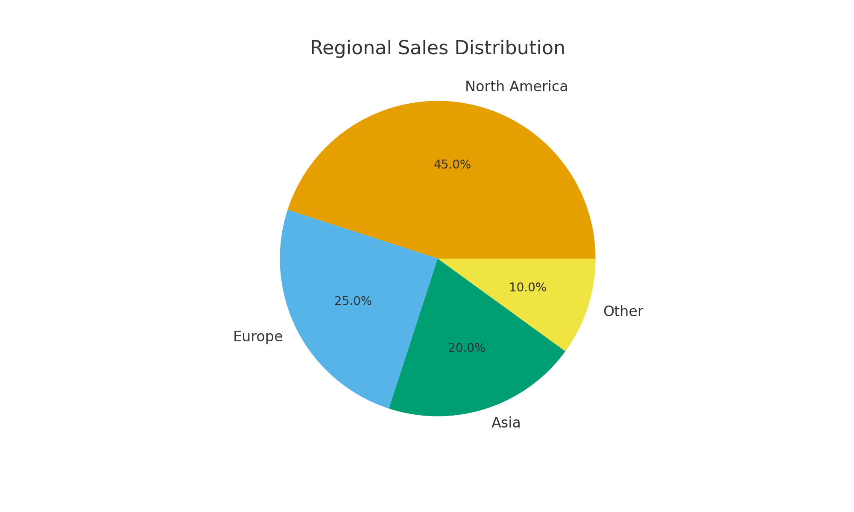
Regional Sales Distribution

Slide 5
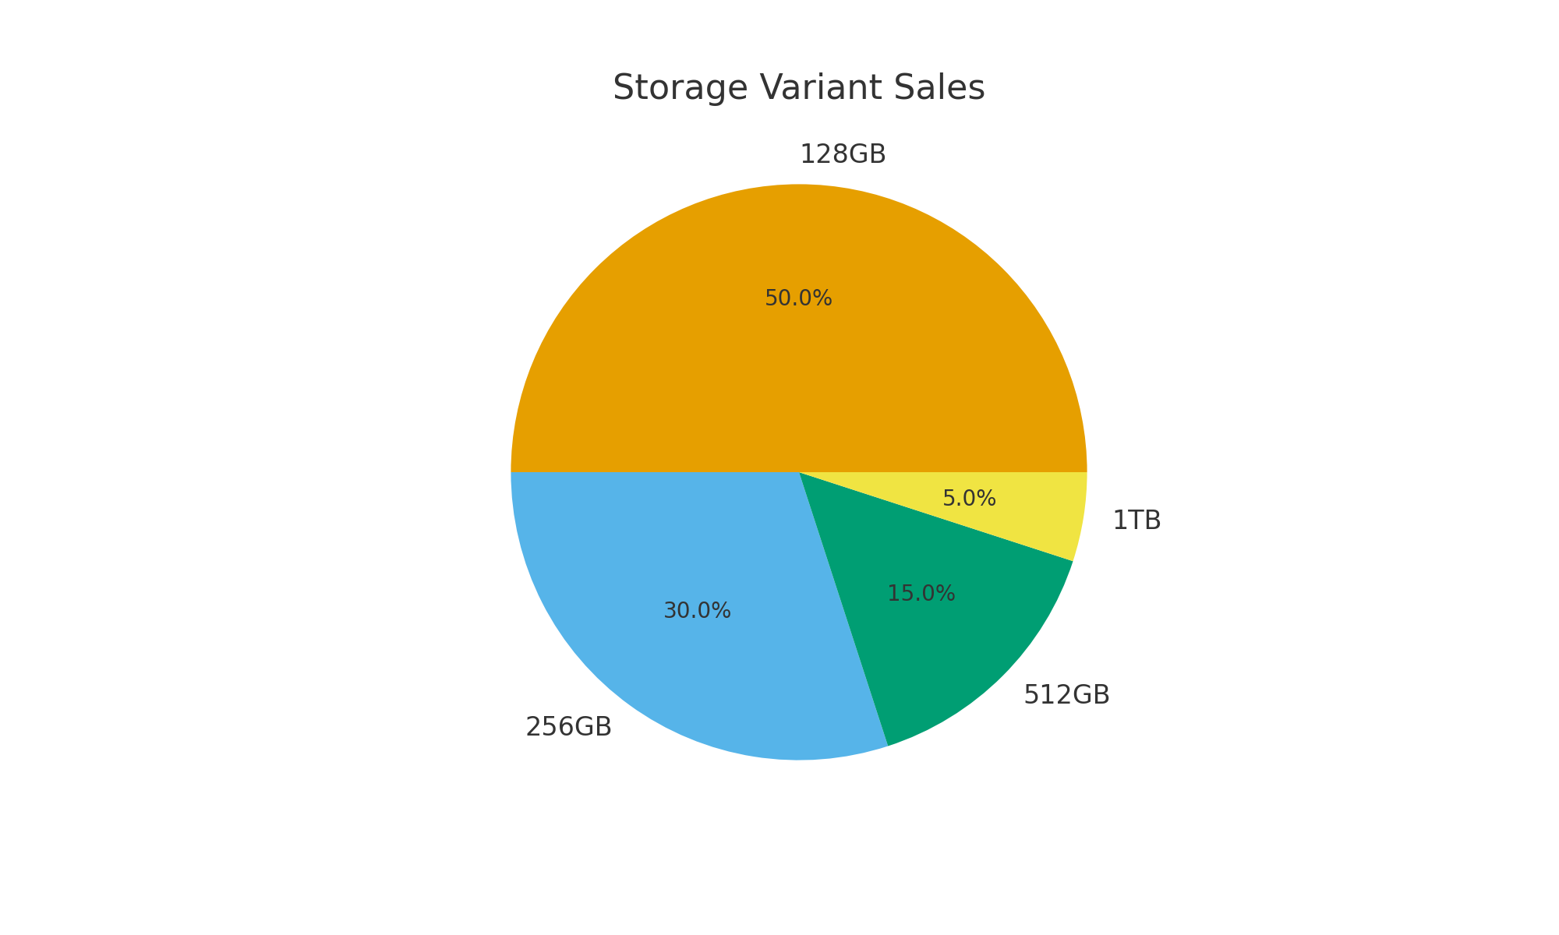
Storage Variant Sales

Slide 6
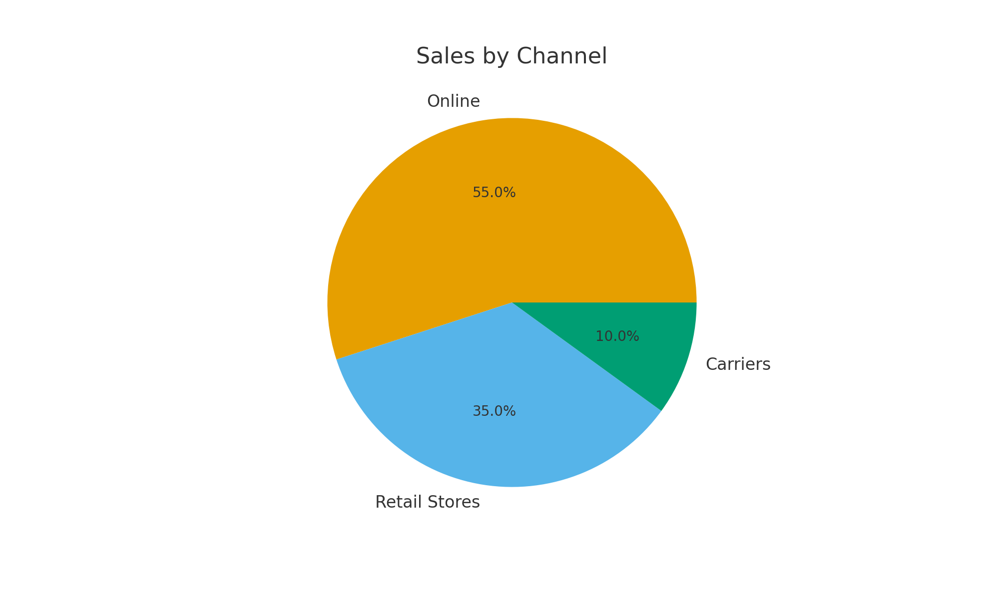
Sales by Channel

Slide 7
Insights
- iPhone 15 remains the top-selling model
- North America contributes the highest sales share
- Most users prefer 128GB storage
- Online purchases exceed retail and carrier sales

Slide 8
Conclusion
This expanded fictional analysis helps visualize key business metrics across multiple factors.

